Slide 1
Image Registration using Deep Reinforcement Learning
Nuntanut Raksasri, Yice Luo, Jinxin Xiong, Hengda He

Slide 2
Agenda
Background and Motivation
Related Work
Experiment 1 - Affine Transformation
Backgrounds
Methods
Results
Experiment 2 - Nonlinear Deformation
Backgrounds
Methods
Results
Discussion and Future Work

Slide 3
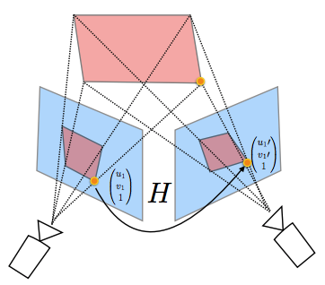
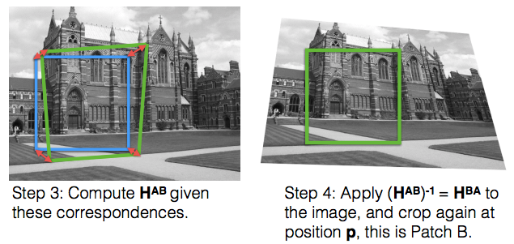
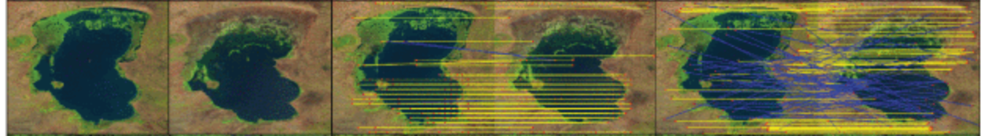
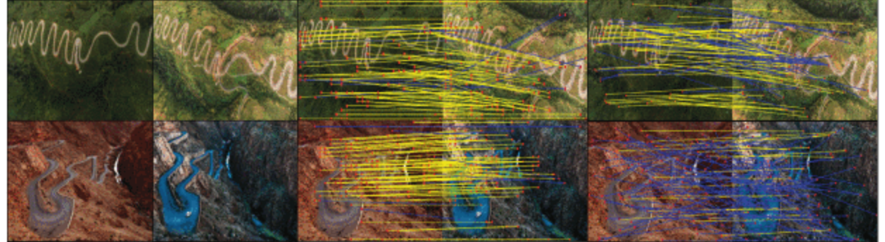
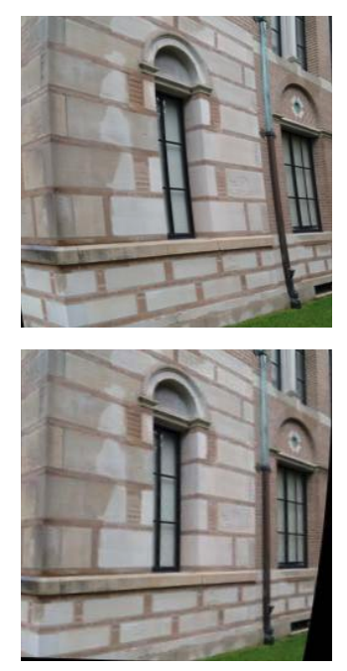
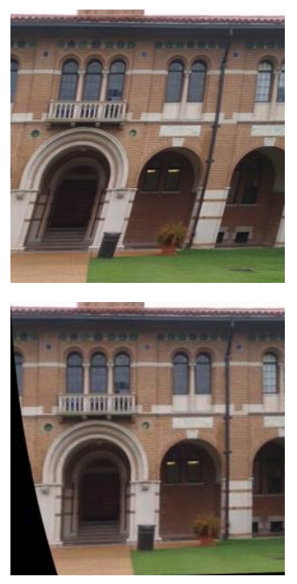
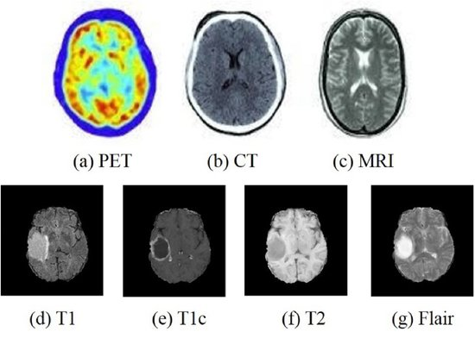
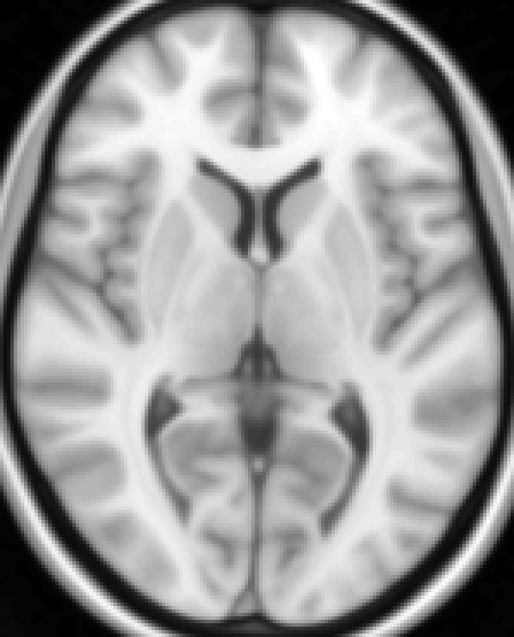
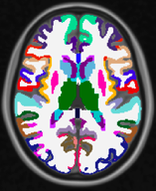
Why image registration?
Computer Vision
Aligning two or more images into the same coordinate.
Homography registering
Feature-point registration
Biomedical Engineering
Spatial normalization
Distortion correction
Yang, Zhuoqian, Tingting Dan, and Yang Yang. "Multi-temporal remote sensing image registration using deep convolutional features." IEEE Access 6 (2018): 38544-38555.
DeTone, Daniel, Tomasz Malisiewicz, and Andrew Rabinovich. "Deep image homography estimation." arXiv preprint arXiv:1606.03798 (2016).
Rengarajan, Vijay, Yogesh Balaji, and A. N. Rajagopalan. "Unrolling the shutter: Cnn to correct motion distortions." Proceedings of the IEEE Conference on computer Vision and Pattern Recognition. 2017.
Zhou, Tongxue, Su Ruan, and Stéphane Canu. "A review: Deep learning for medical image segmentation using multi-modality fusion." Array 3 (2019): 100004.
Brain atrophy
Myocardial deformation
...
Multi-modality registration
Notes:
(Hengda)
Applications
Motion correction
Multi-modality image fusion
Geometric distortion correction
Image segmentation
Computational anatomy

Slide 4
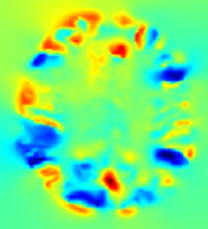
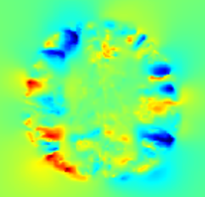


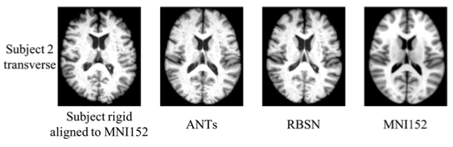
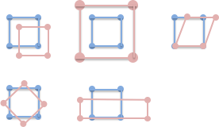
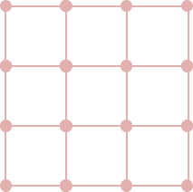
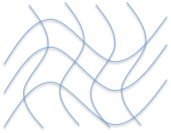
What is image registration?
An optimization problem, Objective Function = Match Distance + Regularization
Quantify and minimize the difference between image pairs
x
y
Linear Transformation
Nonlinear Deformation
3x3 matrix
6 DoF
Pixel-wise displacement vector field
Notes:
(Hengda)
It’s optimization problem
Introduce affine and nonlinear registration

Slide 5
Motivation and Related work
Image registration problems have been formulated as MDP and can be solved with robust performance.
(Sun et al. ACCV 2018) (Liao et al. AAAI 2017) (Miao et al. AAAI 2018) linear transformation
State space:
moving and fixed image at each time frame
transformation parameters at a time point.
Action space:
positive and negative changes in the transformation parameters.
Reward:
landmark error
distance between the ground truth and the current transformation.
(Krebs et al. MICCAI 2017) a non-linear image registration problems with a supervised learning method.
Deformation parameterized as a d-dimensional vector of parameters
2d possible actions were defined and each of them either decreases or increases a specific parameter.
(Furuta et al. IEEE Trans. Multimedia 2019) RL with pixel-wise rewards (pixelRL) for image processing was applied to enhance the explainability and interpretability of DNN.
Notes:
Motivation (Hengda) Related Work (Nat)
Local minimum problem in current methods (figure)
It’s an optimization problem, time sequence of image movement (video), no ground truth
One sentence for each paper

Slide 6
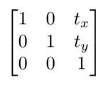
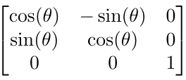
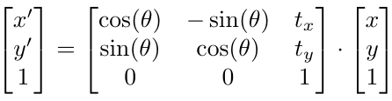
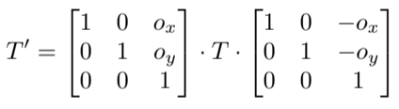
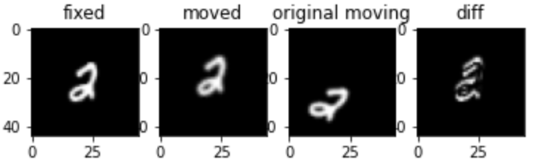
Experiment 1 - Affine Transformation
Backgrounds
Translation:
Rotation:
We use tf.keras.preprocessing.image.apply_affine_transform to do the transformation
Center offset: Ox=W/2 - 0.5; Oy=H/2-0.5
Interpolation: relocates pixels requiring intensity interpolation to approximate the value of moved pixels
Use the function to generate the moving image (MNIST), and try to use RL to find a sequence of actions to transform it to be as similar as possible to the original fixed image.
Notes:
(Jin)
affine transformations include translation, scaling, reflection, rotation, shear mapping, and compositions of them in any combination and sequence

Slide 7
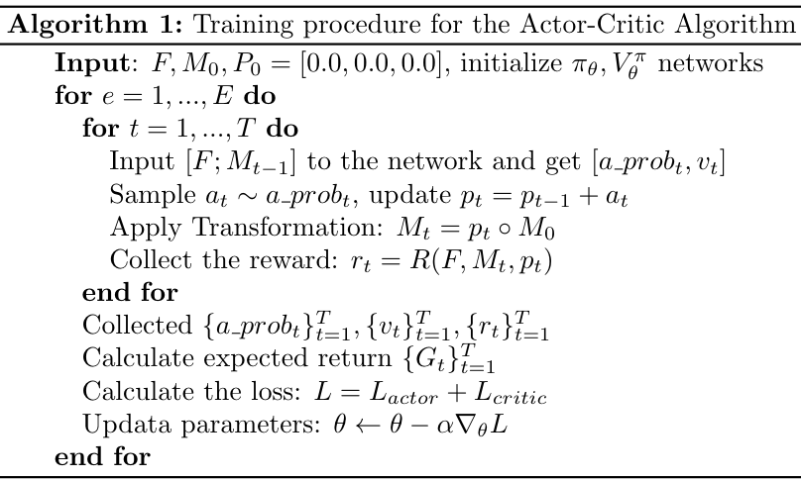
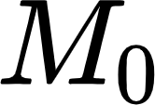
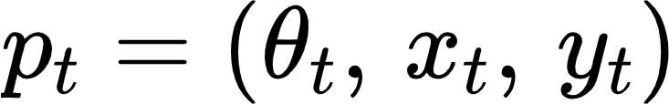
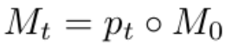
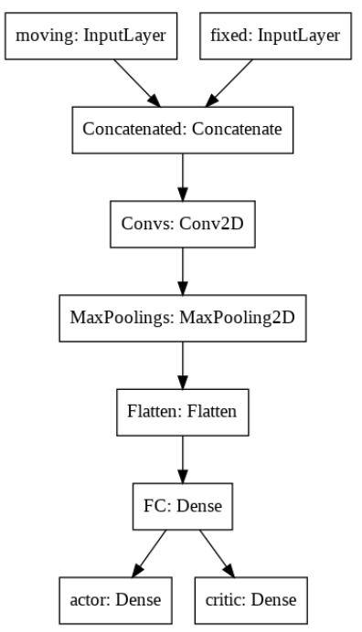
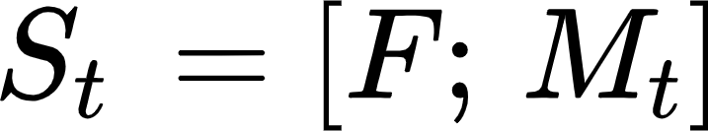

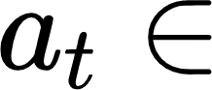
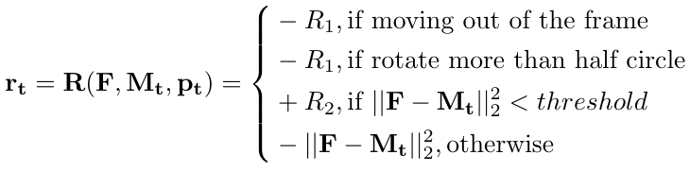
Experiment 1 - Affine Transformation
Methods: Actor - Critic
Fixed Image: F, Initial moving image:
Transformation parameters:
Moving Image:
State:
Action:
+/- 30 ; x +/- 1 ; y +/- 1
{[30, 0, 0], [0, 1, 0], [0, 0, 1],
[-30, 0, 0][0, -1, 0], [0, 0, -1]}
Reward:
Notes:
(Jin)

Slide 8
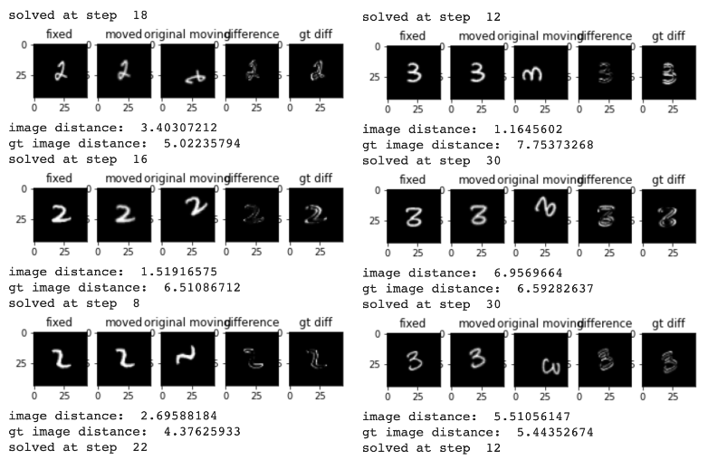



Experiment 1 - Affine Transformation
Results
Resize the MNIST datasets to 44*44
Randomly generate the moving images by apply transformation sample from:
Trained on number 2:
Failed Example:
Notes:
Video demonstration (Jin)

Slide 9
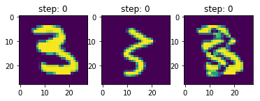
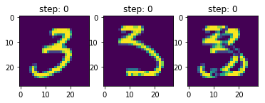
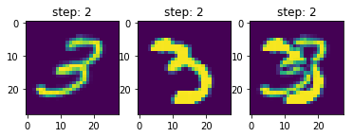


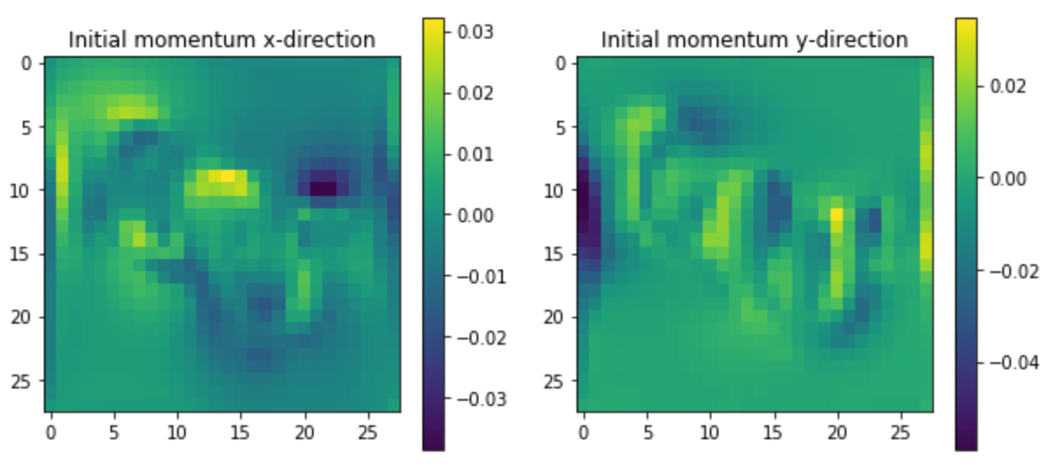
Experiment 2 - Nonlinear Deformation
F
Backgrounds
Nonlinear deformation can be parametrized by m0 (initial momentum).
m0 has shape (H,W,2).
x-axis; m0[...,0];m0[...,1]: y-axis
MNIST dataset as images
Using LDDMM for shooting from M(0) to M(t)
Input images: F (a fixed image),M (a moving image)
Controller: m0
M(t)
M(t+1)
m0
M(t)
Training an agent to learn how to sequentially update shooting parameters to match moving and fixed images.
F
M(0)
Attempt t -> M(t)
t+1 -> M(t+1)
Deformation parameters: m0 (initial momentum)

Slide 10
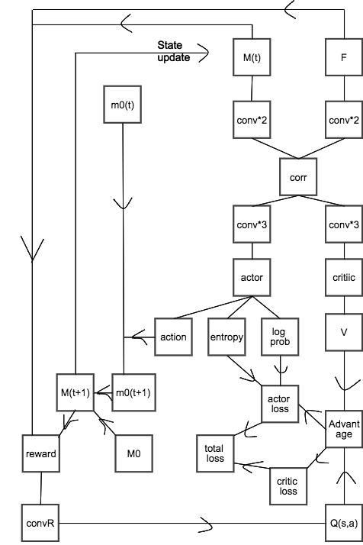
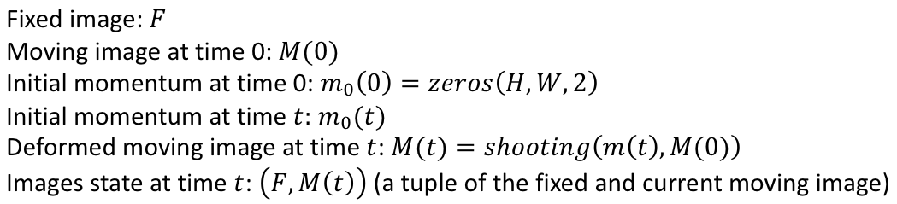
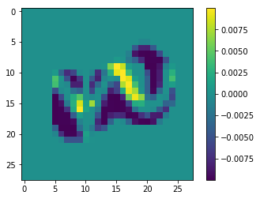
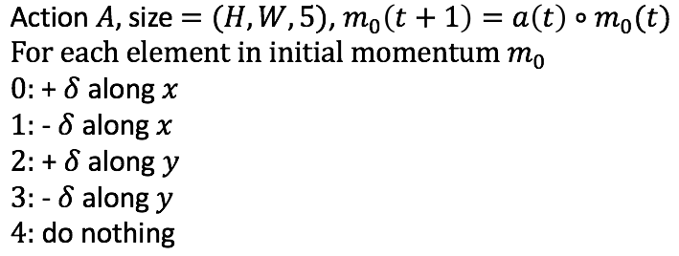
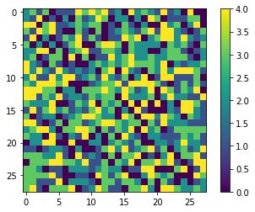
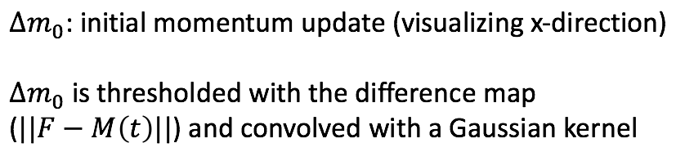
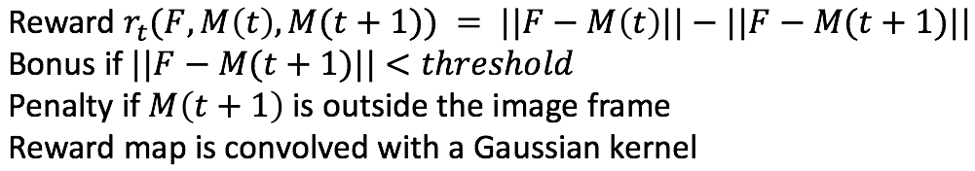
Experiment 2 - Nonlinear Deformation
Methods: Actor - Critic
Collecting trajectories
State
Action
Reward
Update weights in each epoch

Slide 11
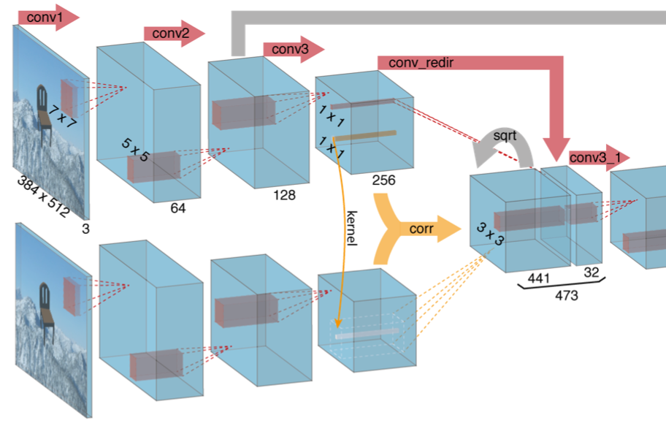
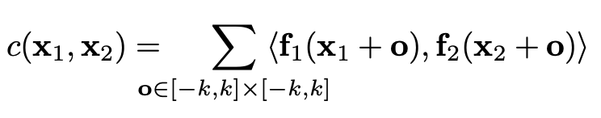
Experiment 2 - Nonlinear Deformation
Methods: Correlation layer
matching process performing multiplicative patch comparisons between two feature maps for correspondences finding in the network
Reference: FlowNet: Learning Optical Flow with Convolutional Networks

Slide 12
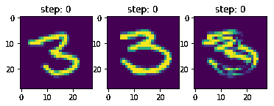
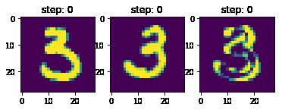
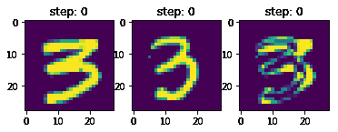
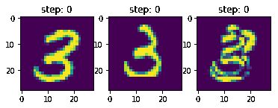
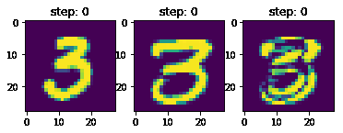
Experiment 2 - Nonlinear Deformation
Results
Moving M(t) Fixed F Difference
Moving M(t) Fixed F Difference
Moving M(t) Fixed F Difference
Moving M(t) Fixed F Difference
Moving M(t) Fixed F Difference
Notes:
Video demonstration

Slide 13
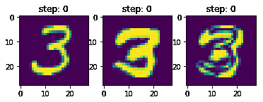
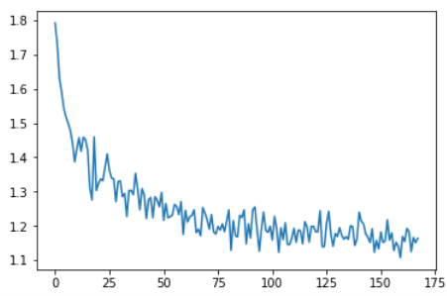
Discussion and Future Work
Real world application
multi-agent/A3C/PPO
Pretrain the feature extractor
Use ground truth trajectories to train the first few epochs
A ground truth trajectory
Supervised training of encoder and actor network (entropy loss)
Notes:
Training with GT trajectories (Hengda)
Others

